Slide 1
God’s Sacred Temple
1 Corinthians 3:16-17

Slide 2
¹⁶ Don’t you know that you yourselves are God’s temple and that God’s Spirit dwells in your midst?
¹⁷ If anyone destroys God’s temple, God will destroy that person; for God’s temple is sacred, and you together are that temple.

Slide 3
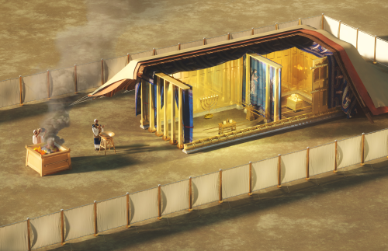
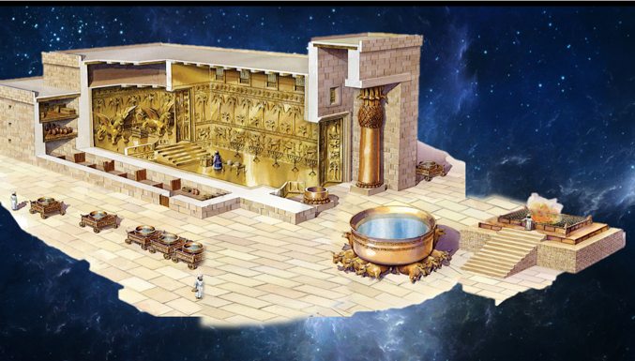

Slide 4
“you yourselves are God’s temple”
What kind of place is temple/sanctuary?
If Christians are God’s temple/sanctuary, then what is the one furnishing we must have in individual and in corporate life for worshipping and offering sacrifice to God?
ALTAR
Romans 12:1 “offer your bodies as a living sacrifice, holy and pleasing to God—this is your true and proper worship.”

Slide 5
עבד - “To Serve”
1 Peter 2:9 “But you are a chosen people, a royal priesthood, a holy nation, God’s special possession, that you may declare the praises of Him who called you out of darkness into His wonderful light.”
For Israel, from serving Pharoah in Egypt to serving God in Sinai.
For Christians, from serving Satan in sin to serving God through Christ and building God’s temple.

Slide 6
“you yourselves are God’s temple”
God’s temple is God’s exclusive possession (1 Peter 2:9).
How should we then live as God’s temple, His special possession?
Live for God, for His glory, through the power of the Holy Spirit.
1 Cor. 6:19-20 “¹⁹ Do you not know that your bodies are temples of the Holy Spirit, who is in you, whom you have received from God? You are not your own; ²⁰ you were bought at a price. Therefore honor God with your bodies.”
Romans 12:1 “I urge you, brothers and sisters, in view of God’s mercy, to offer your bodies as a living sacrifice, holy and pleasing to God—this is your true and proper worship.”

Slide 7
Jesus Christ, God’s PERFECT temple is SACRED
John 1:14 “The Word became flesh and made His dwelling (tabernacled) among us. We have seen His glory, the glory of the one and only Son, who came from the Father, full of grace and truth.”
John 2:18-22 “¹⁸ The Jews then responded to Him, ‘What sign can You show us to prove Your authority to do all this?” ¹⁹ Jesus answered them, ’Destroy this temple, and I will raise it again in three days.’ ²⁰ They replied, ‘It has taken forty-six years to build this temple, and You are going to raise it in three days? ²¹ But the temple He had spoken of was His body. ²² After He was raised from the dead, His disciples recalled what He had said. Then they believed the scripture and the words that Jesus had spoken.”

Slide 8
v. 17 “ If anyone destroys God’s temple, God will destroy that person; for God’s temple is sacred, and you together are that temple.” (retribution)
Romans 12:2 “Do not conform to the pattern of this world, but be transformed by the renewing of your mind. Then you will be able to test and approve what God’s will is—His good, pleasing and perfect will.”
Ephesians 2:10 “For we are God’s handiwork, created in Christ Jesus to do good works, which God prepared in advance for us to do.”
2 Timothy 3:16-17 “¹⁶ All Scripture is God-breathed and is useful for teaching, rebuking, correcting and training in righteousness, ¹⁷ so that the servant of God may be thoroughly equipped for every good work.”

Slide 9
Psalms 96: 5-6 ⁵ For all the gods of the nations are idols, but the Lord made the heavens. ⁶ Splendor and majesty are before Him; strength and glory are in His sanctuary.
Psalms 65: 4 “Blessed are those You choose and bring near to live in Your courts! We are filled with the good things of Your house, of Your holy temple.”

Slide 10
The Inner Beauty of God’s Temple
Galatians 5:22-26
²² But the fruit of the Spirit is love, joy, peace, forbearance, kindness, goodness, faithfulness, ²³ gentleness and self-control. Against such things there is no law. ²⁴ Those who belong to Christ Jesus have crucified the flesh with its passions and desires. ²⁵ Since we live by the Spirit, let us keep in step with the Spirit. ²⁶ Let us not become conceited, provoking and envying each other.

Slide 11
“The supreme beauty of a true Christian life is that the sacrifice of the Christian is properly a sacrifice—that is, an offering to God, done for the sake of the great love wherewith He has loved us. As Christ is the one true Temple, and we become so by partaking of Him, so He is the one Sacrifice for sins for ever, and we become sacrifices only through Him. If there be any lesson which comes out of this great truth of Christians as temples, it is not a lesson of pluming ourselves on our dignity, or losing ourselves in the mysticisms which lie near this truth, but it is the hard lesson—If a temple, then an altar; if an altar, then a sacrifice.”
-- ALEXANDER MACLAREN, (Scottish baptism minister in19th century)

Slide 12
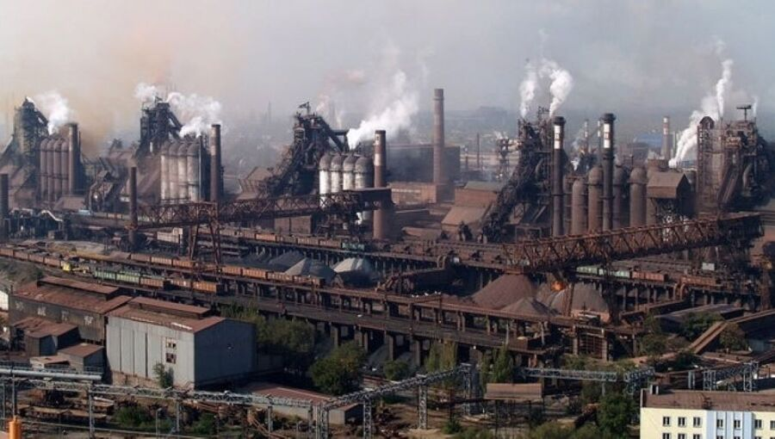
Ukrainian fighters in the tunnels underneath Mariupol’s pulverized steel plant held out against Russian troops Thursday in an increasingly desperate and perhaps doomed effort to deny Moscow what would be its biggest success of the war yet: the complete capture of the strategic port city…
The fall of Mariupol would deprive Ukraine of a vital port, allow Russia to establish a land corridor to the Crimean Peninsula, which it seized from Ukraine in 2014, and free up troops to fight elsewhere in the Donbas, the eastern industrial region that the Kremlin says is now its chief objective.
The defenders will “stand till the end. They only hope for a miracle," Kateryna Prokopenko said after speaking by phone to her husband, a leader of the steel plant defenders. "They won’t surrender.”
(US News & World Report, 5/5/22)

Slide 13
Doxology
Praise God from whom all blessings flow
Praise Him all creatures here below
Praise Him above ye heavenly hosts
Praise Father, Son and Holy Ghost

